Slide 1

Excel to ASIARS-Net User’s Guide
JANIS Team
National Institute of Infectious Diseases, Japan
Notes:
Thank you very much for your coming.
Today I’d like to speak about the tool of combining Excel to JANIS.

Slide 2
Welcome to ASIARS-Net system!
These slides show how to convert your Excel file to an ASIARS-Net format text file.
We hope you utilize ASIARS-Net system to act against AMR!
Notes:
These slides show how to convert your Excel file to a JANIS format text file.
We hope you utilize JANIS system to act against AMR.

Slide 3
Steps
Import an Excel file containing surveillance data.
Make "mapping template".
Expand "mapping template" to the other sheets.
Output the result of mapping.
Convert input data into an ASIARS-Net format text file.
Notes:
This slide shows the steps how to create JANIS format files

Slide 4
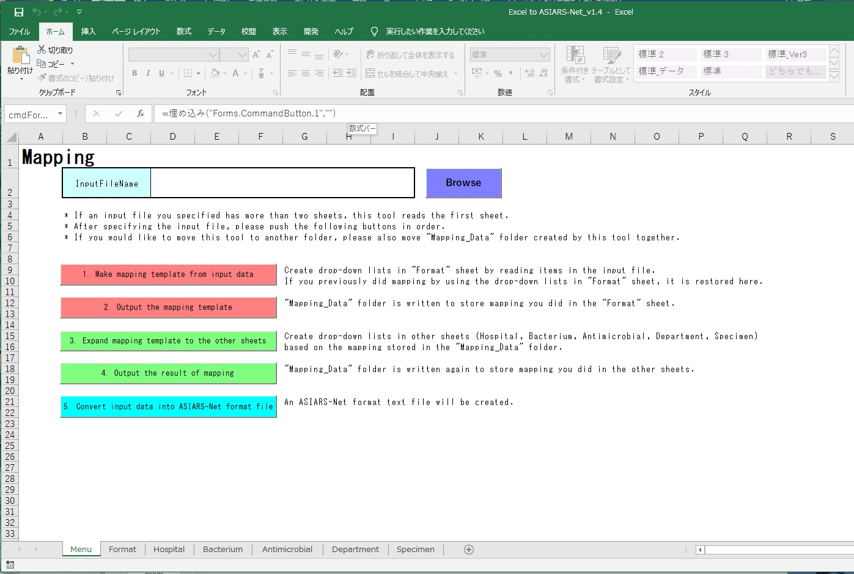
1. Import an Excel file containing surveillance data.
Click [Browse] and select an Excel file

Slide 5

2. Make "mapping template".
Click this button
It creates drop-down lists in "Format" sheet
(see the next page) by reading items in the input Excel file.

Slide 6
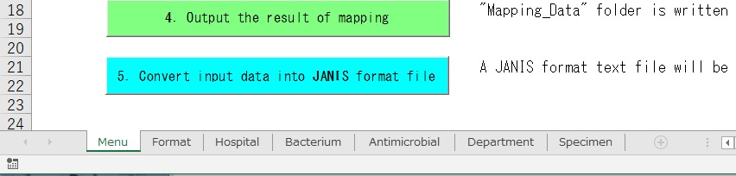
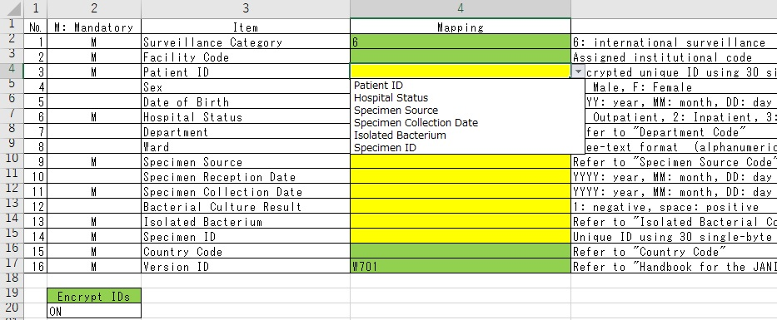
2. Make "mapping template".
Click “Format” tab
Select which column in your Excel file corresponds to which item

Slide 7

2. Make "mapping template".
Click this button
"Mapping_Data" folder is written
to store mapping you did in the "Format" sheet.

Slide 8

3. Expand "mapping template" to the other sheets.
Click this button
Create drop-down lists in the other sheets
(Hospital, Bacterium, Antimicrobial, Department, Specimen)
based on the mapping stored in the "Mapping_Data" folder.

Slide 9
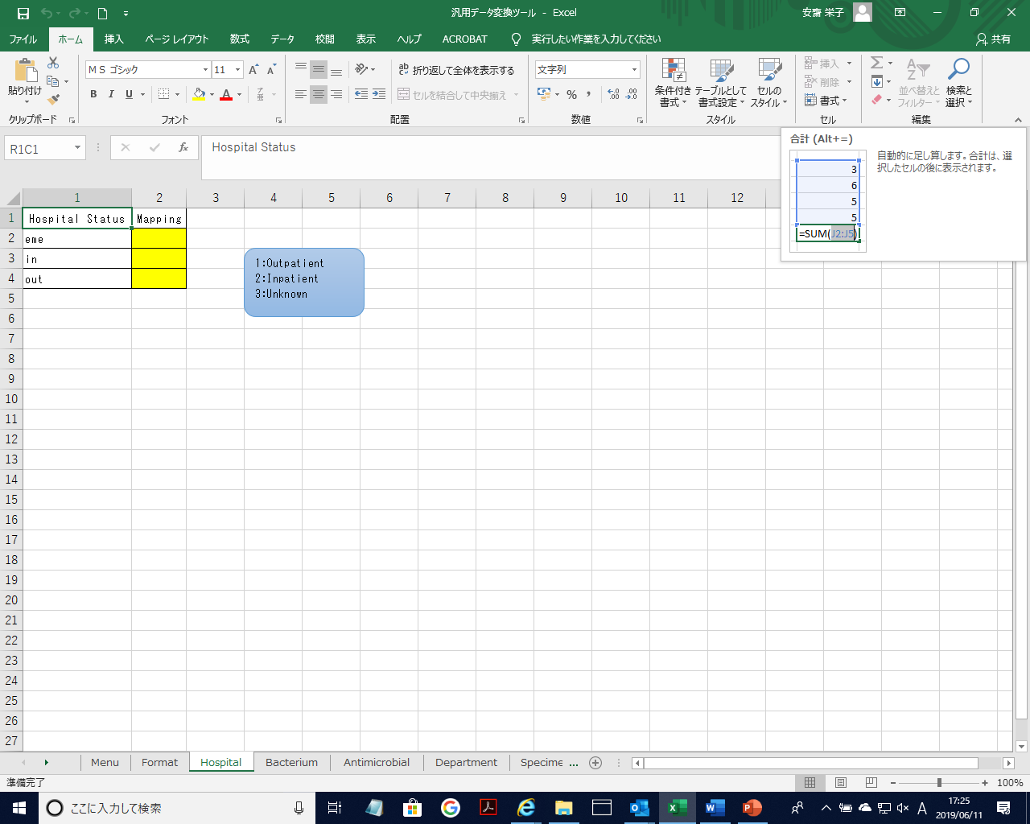

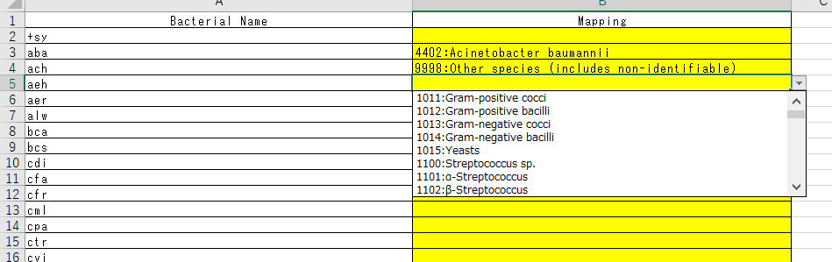
3. Expand "mapping template" to the other sheets.
Click these tabs
e.g. In “Bacterium” tab,
Bacteria name in your
input file
Select a name (code)
defined in JANIS
Similarly, please do mapping in the remaining sheets

Slide 10

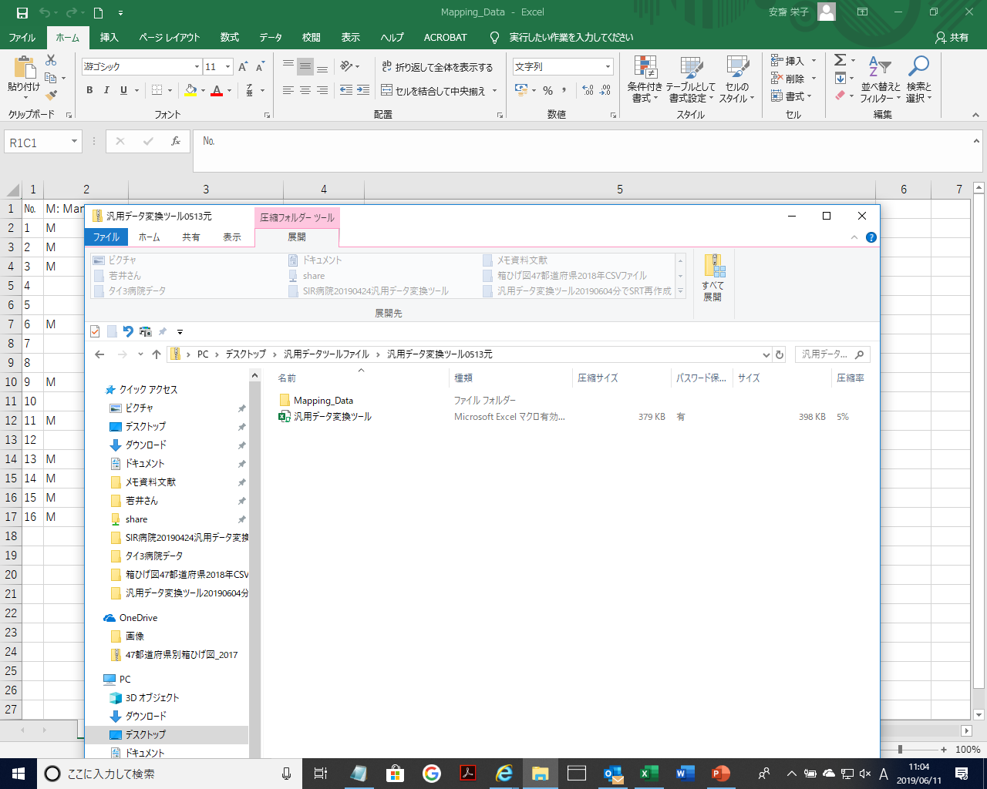
4. Output the result of mapping.
Click this button
[Mapping Date] folder is written again
to store mapping you did
Notes:
And then, Output the result of mapping

Slide 11
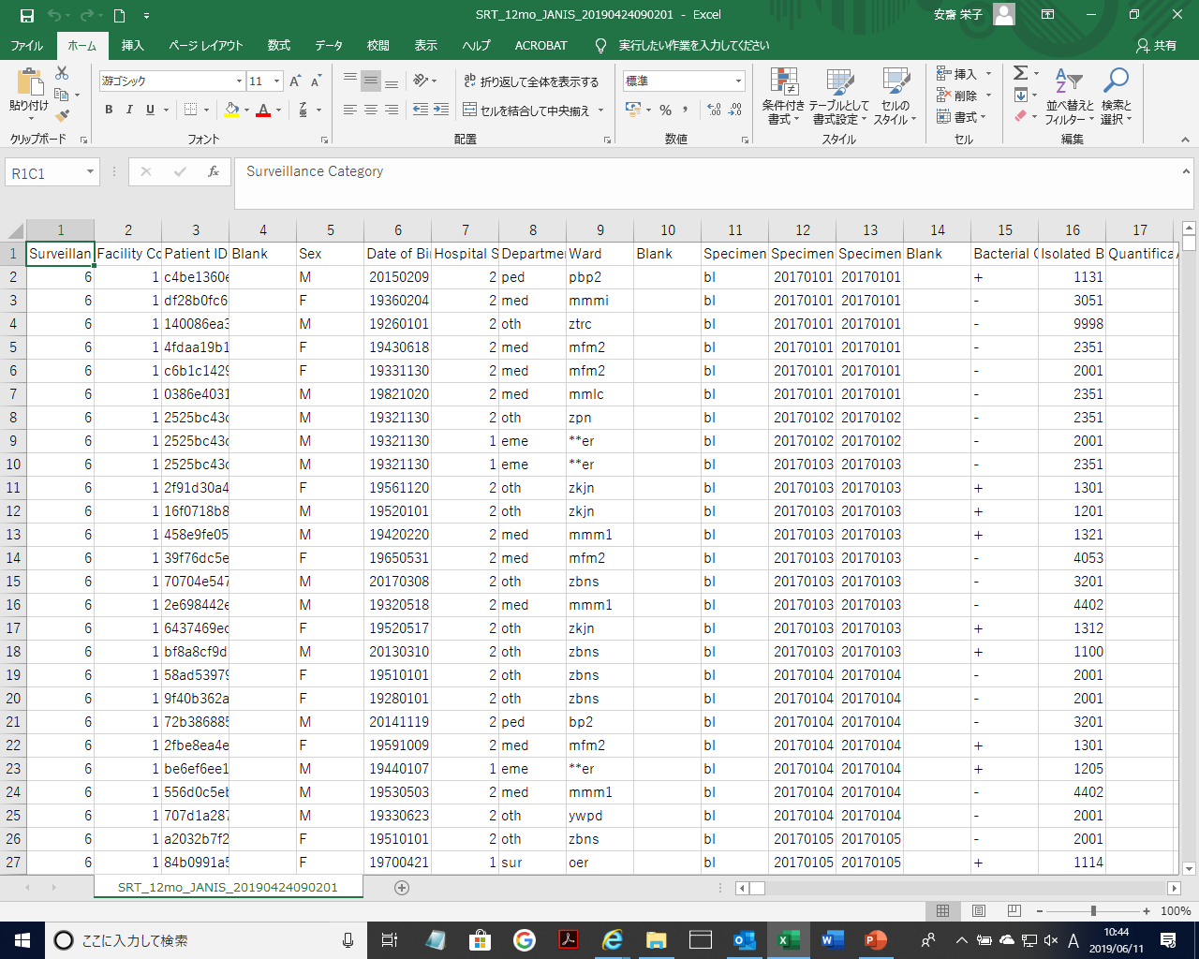
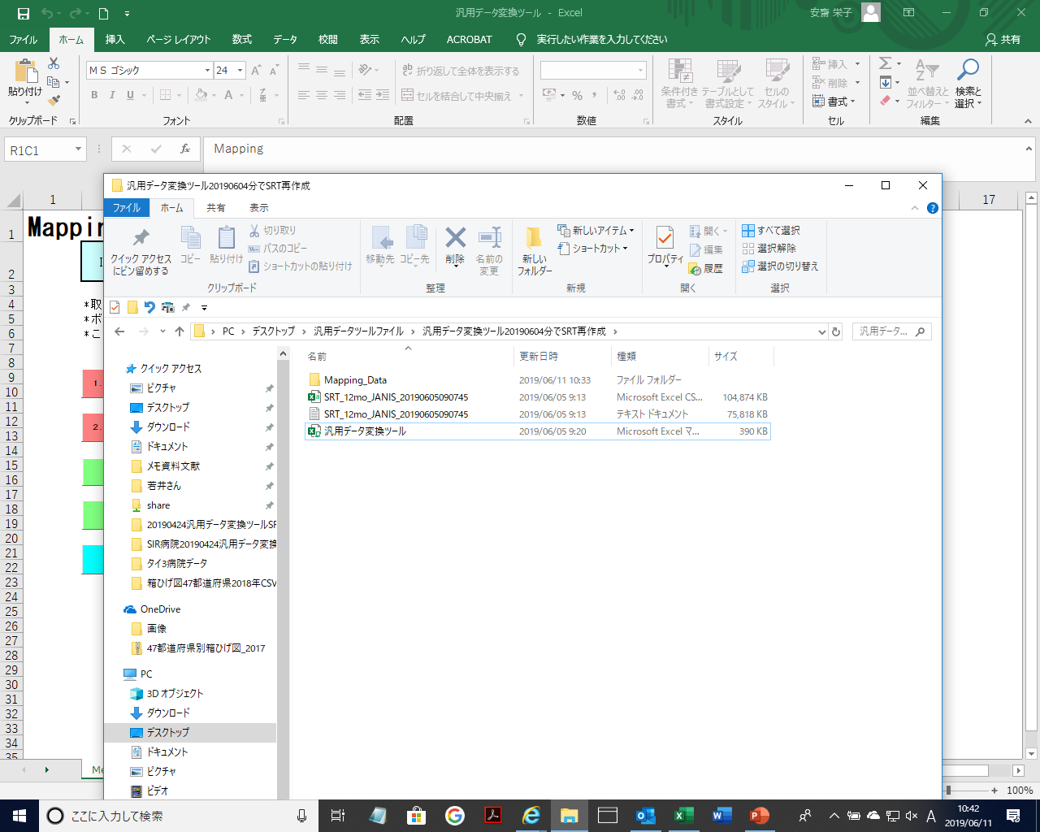
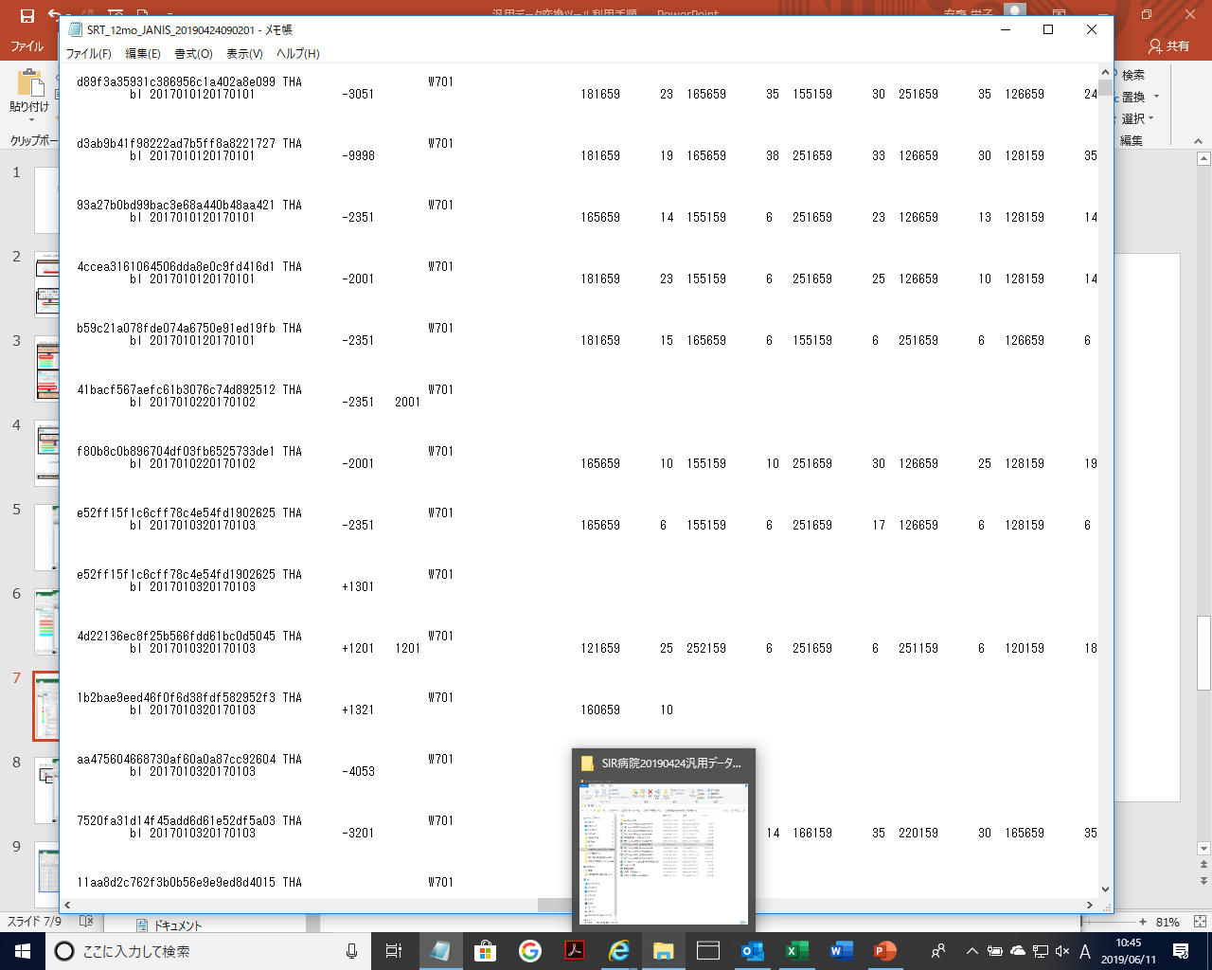
5. Convert input data into a JANIS format text file.
Click this button
[CSV] and [txt] files are created next to the “Mapping Data” folder.
Notes:
Finally, Convert input data into an ASIARS-Net format text file.
Click “Convert input data into ASIARS-Net format file” button
[CSV] and [txt] files are created next to the “Mapping Data” folder.

